Slide 1
Learning Processes (PART 1)

Slide 2
Introduction
An ANN learns through an interactive process of adjustments to its synaptic weights and bias levels
A set of well-defined rules for solving the learning problem is called a learning algorithm.
There is no single learning algorithm for all ANNs. We rather have a variety of learning algorithms, each with its own advantages
Also, different ways for an ANN to relate to its environment (and hence, learn) lead us to different learning paradigms

Slide 3
Chapter Organization
Learning rules
Error-correction learning
Memory-based learning
Hebbian learning
Competetive learning
Boltzman learning
Learning paradigms
Credit-assignment problem
Learning with a teacher
Learning without a teacher
Learning tasks, memory, and adaptation
Probabilistic and statistical aspects of learning (omitted)

Slide 4
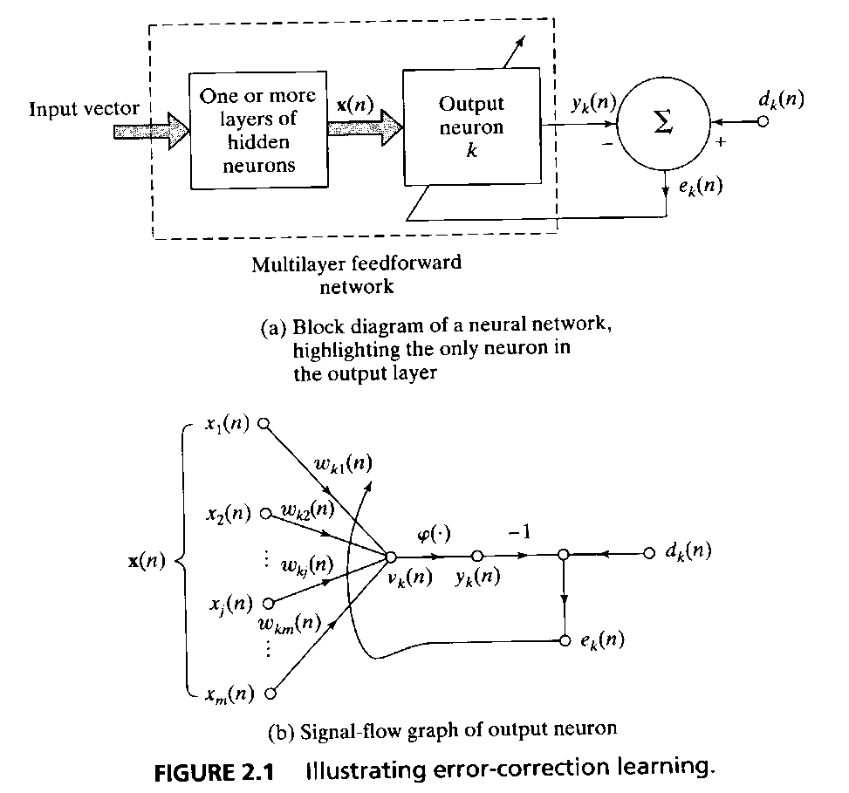
Error-Correction Learning
Neuron k is driven by signal vector x(n) produced by hidden layers
n denotes discrete time step
y_{k}(n) is the output of neuron k at time n
d_{k}(n) denotes desired output at time n
After comparing actual and desired outputs, we obtain an error signal, e_{k}(n)

Slide 5
Error-Correction Learning
e_{k}(n) actuates a control mechanism (a sequence of corrective adjustments to synaptic weights of neuron k)
The aim of these adjustments is to make y_{k}(n) come closer to d_{k}(n) step-by-step.
To do this, we need to minimize a cost function
(instant value of error energy)

Slide 6
Error-Correction Learning
The adjustments to the weights are continued until system reaches a steady state
Delta rule: the adjustment Δw_{kj}(n) for the weight w_{kj} at time step n is
where η is the learning rate parameter
When this is calculated, synaptic weight is updated with

Slide 7
Memory-Based Learning
All (or most) past experiences are stored as correctly classified input-output examples {(x_{i},d_{i})}^{N}_{i=1}
When a new input signal, x_{test} is given, system responds by looking at nearby known data
E.g., nearest neighbor, k-nearest neighbors, radial-basis function network, etc.

Slide 8
Hebbian Learning
Neuropsychologist Hebb’s postulate of learning (1949) says (in short) that, when cell A repeatedly and persistently takes part in firing cell B, changes take place so that A fires B better.
In ANN context, this is expressed as a two-part rule
If neurons on either side of a synapse are activated simultaneously, then synapse strength is increased
If neurons on either side of a synapse are activated asynchronously, then synapse strength is decreased.
Such a synapse is called a Hebbian synapse.
A Hebbian synapse uses a time-dependent, highly local, and strongly interactive mechanism to increase synaptic efficiency as a function of correlation between presynaptic and postsynaptic activities.

Slide 9
Hebbian Learning
Synaptic weight w_{kj} for neuron k with presynaptic signal x_{j} and postsynaptic signal y_{k}. The adjustment to w_{kj} at time n (in general form) is
where F(.,.) is a function of both pre and post synaptic signals.
Hebb’s hypothesis
Covariance hypothesis
and are time averaged values

Slide 10
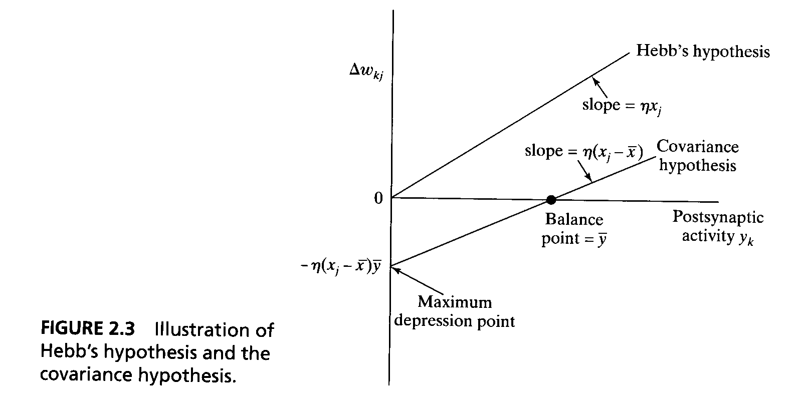
Hebbian Learning

Slide 11
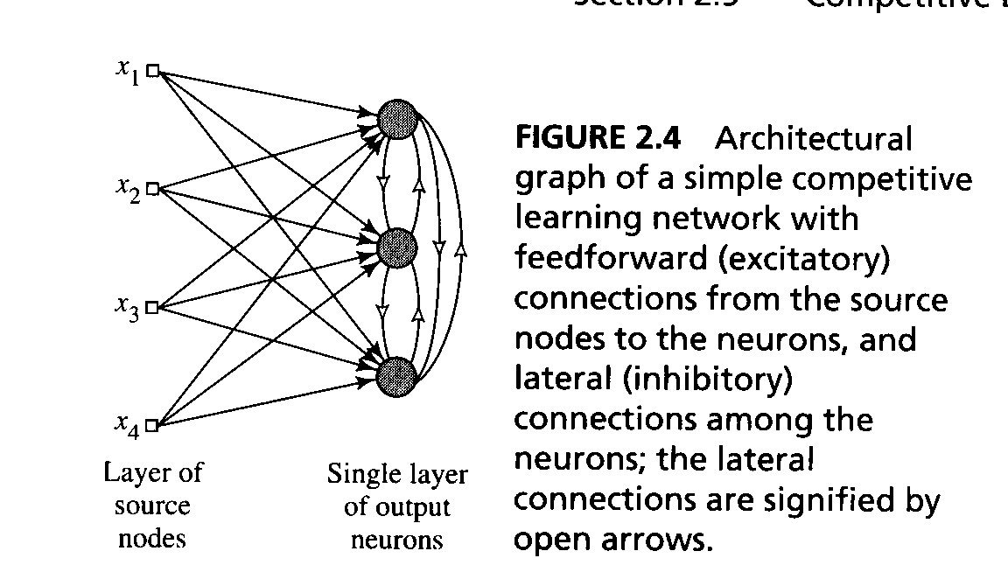
Competitive Learning
The output neurons of a neural network compete among themselves to become active.
a set of neurons that are all the same (except for synaptic weights)
a limit imposed on the strength of each neuron
a mechanism that permits the neurons to compete -> a winner-takes-all

Slide 12
Competitive Learning
The standard competitive learning rule
Δw_{kj} = η(x_{j}-w_{kj}) if neuron k wins the competition = 0 if neuron k loses the competition
Note: all the neurons in the network are constrained to have the same length.

Slide 13
Boltzmann Learning
The neurons constitute a recurrent structure and they operate in a binary manner. The machine is characterized by an energy function E where x_{k}and x_{j} are neuron states
E = -½Σ_{j}Σ_{k} w_{kj}x_{k}x_{j} , j≠k
Machine operates by choosing a neuron at random then flipping the state of neuron k from state x_{k} to state –x_{k} at some temperature T with probability
P(x_{k}→ - x_{k}) = 1/(1+exp(- ΔE_{k}/T))
where ΔE_{k} is the energy change and T is a pseudotemperature

Slide 14
Boltzmann Learning
Clamped condition: the visible neurons are all clamped onto specific states determined by the environment
Free-running condition: all the neurons (=visible and hidden) are allowed to operate freely
The Boltzmann learning rule:
Δw_{kj} = η(ρ⁺_{kj}- ρ⁻_{kj}), j≠k,
note that both ρ⁺_{kj} and
ρ⁻_{kj} range in value from –1 to +1.

